Slide 1

What do you like:
Indonesian Food Recommendation
Fajri Ilham Mughni
Updated on 19th April, 2025

Slide 2
Personal Background

Slide 3


Fajri Ilham Mughni
Education
What do I do:
Data Science Student @ DBB Batch 29
Geological Eng. Graduate @ ITB 2018
Subsurface Data Management, Jr. Consultant
at Husky-CNOOC Madura Ltd. (2024 – present)
LinkedIn:
Fajri Ilham Mughni
My writing:
Medium

Slide 4
Outline :
Goals
Data Understanding
Processing the Data
Deliverables

Slide 5
What are we talking about
Goals

Slide 6
This analysis aims to understand the food preferences of Indonesian society by integrating food consumption data, nutritional information, and traditional Indonesian recipes. Through a process of data cleaning, feature transformation, mapping between recipe ingredients and nutritional content, and clustering techniques using machine learning algorithms, this project produces groupings (clusters) of foods based on calorie content, preference level (loves), and ingredient characteristics. The results of this clustering provide preliminary insights into consumption patterns, nutritional awareness, and the potential segmentation of traditional foods that can be leveraged for consumer behavior research and public health strategy.
Goals/Objective :

Slide 7
Data Understanding

Slide 8
Source of data
All scripts, data, and other technical part of the project can be accessed in this link

Slide 9

Data Understanding:
All description about the data can be accessed through this link
This dataset illustrates the influence of cultural dimensions, particularly cultural values and practices, on food consumption patterns among urban communities in Indonesia. The data was collected from 710 respondents across five major cities through direct interviews. The findings indicate that cultural dimensions play a more dominant role than economic and health factors, especially among the lower-middle class, while the upper class is more influenced by economic factors and modern healthy lifestyle trends.
"DATASET_cultural dimension of food consumption.xlsx"
"dataset-ayam.csv"
"nutrition.csv"
Indonesian cuisine is a rich and diverse cultural heritage, originating from over 300 ethnic groups across approximately 6,000 inhabited islands. There are around 5,350 traditional recipes, with 30 considered the most essential. The cuisine ranges from rice-based dishes to street food, influenced by local traditions as well as foreign cultures such as Indian, Middle Eastern, Chinese, Polynesian, and Melanesian.
Indonesia possesses a rich variety of foods with high nutritional value. This dataset, sourced from the Indonesian Food Composition Table, contains 1,346 entries of traditional foods and beverages, including information on calories, protein, fat, carbohydrates, and image links. This data is valuable for understanding the nutritional content of food consumption in Indonesia.The dataset originates from the Indonesian Food Composition Table published by the Ministry of Health of the Republic of Indonesia (www.panganku.org).

Slide 10
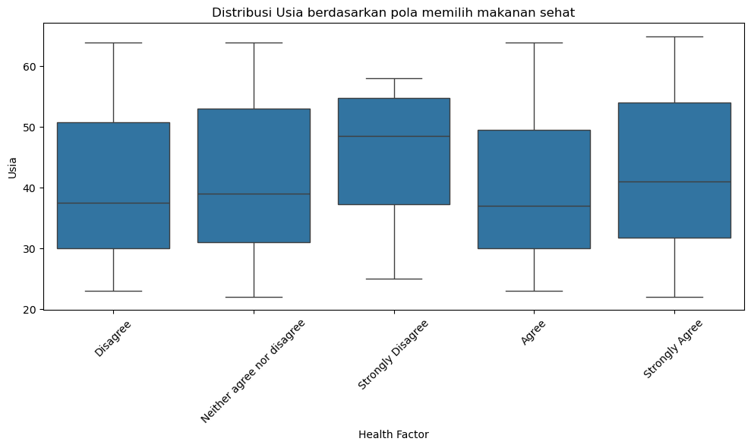
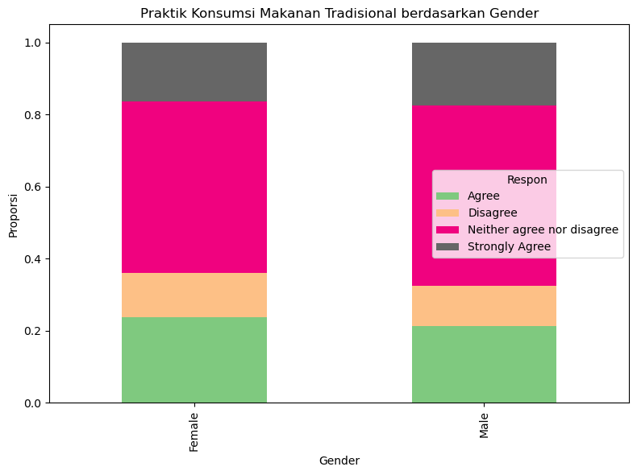
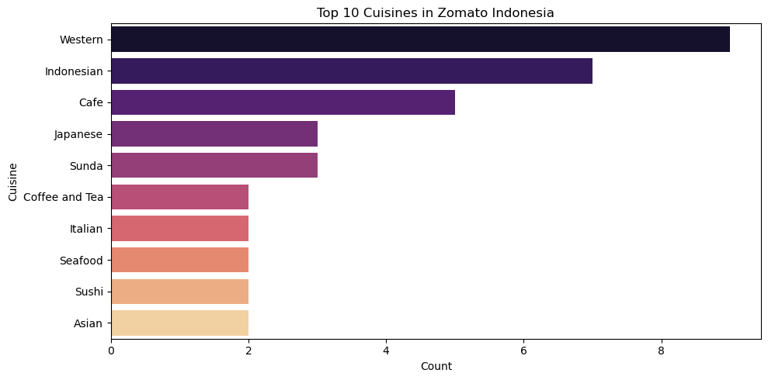
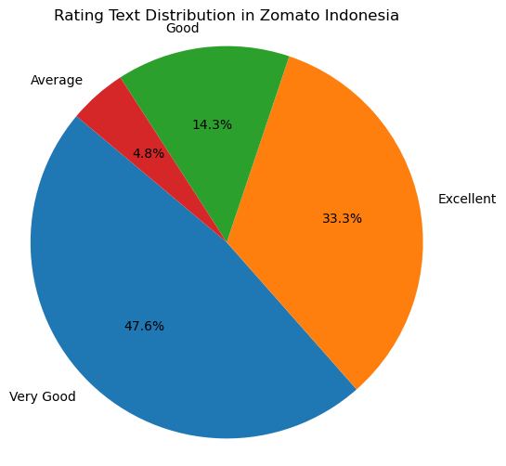
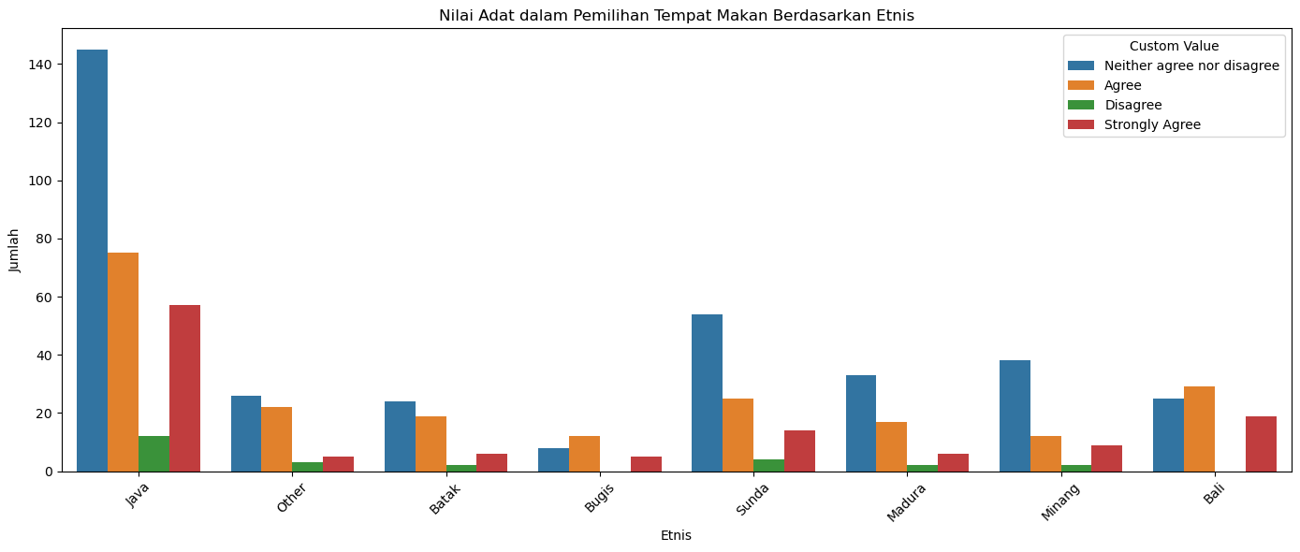
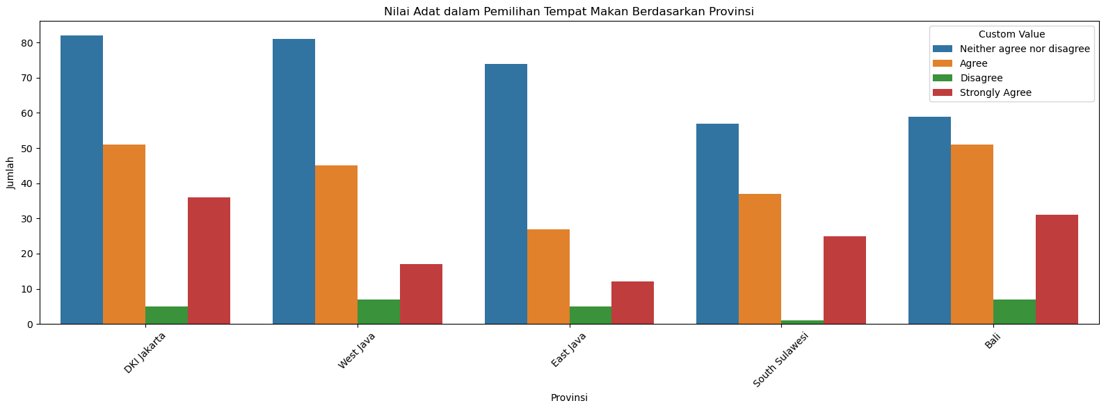
EDA
Notes:
PDB/GDP dihitung dalam satuan miliar dolar AS dengan menggunakan harga konstan tahun 2012

Slide 11
Data Processing

Slide 12
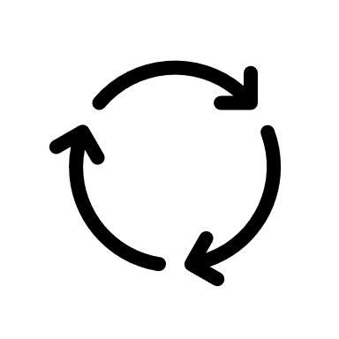
Project Steps for Analysis
Data Cleaning
Handle null values, duplicates, and missing data : Identify and treat empty or missing values, and remove or resolve duplicate records to ensure data integrity.
Split multiple unique values in a single column into separate rows (explode) : If a column contains multiple values (e.g., ingredients separated by commas), separate them into individual rows to facilitate analysis.
Display summary of resultsProvide a summary that includes:
Number of rows and columns
Data distribution (e.g., frequency counts, value ranges)
Initial hypotheses based on patterns or trends observed in the cleaned data
2. Data Transformation
Select relevant columns : Choose only the necessary features from the dataset that are important for further analysis, such as nutritional values, ingredient lists, and consumer demographics.
Review value balance and category distribution : Analyze the distribution of values and category frequencies in both the consumer profile data and the recipe data to understand patterns, detect imbalance, and prepare for modeling or clustering.

Slide 13
Project Steps for Analysis
3. Weighting and Label Encoding
Assign special weights to consumption data : Apply custom weights to reflect specific preferences, such as:
Healthy choices
Traditional food preferences These weights can help the model prioritize recommendations based on cultural or nutritional values.
Encode categorical dataTransform categorical variables (e.g., gender, preferences, age group) into numerical formats using:
Label Encoding
One-Hot Encoding This step is essential to make the data suitable for machine learning algorithms.
4. Data Mapping and Integration : Steps for mapping recipe data with nutritional data
Split the ingredients string into a list : Convert text-based ingredient lists into structured Python lists to enable matching with nutrition data.
Determine the maximum number of ingredients per recipe : Use this to create separate columns for each ingredient
Add a column for the calorie content of each ingredient : Match each ingredient to its corresponding nutritional value (especially calories) from the nutrition dataset.
Calculate the total calories per recipe : Sum the calories of all ingredients in a recipe to create a new feature: **total_calories_estimated**

Slide 14
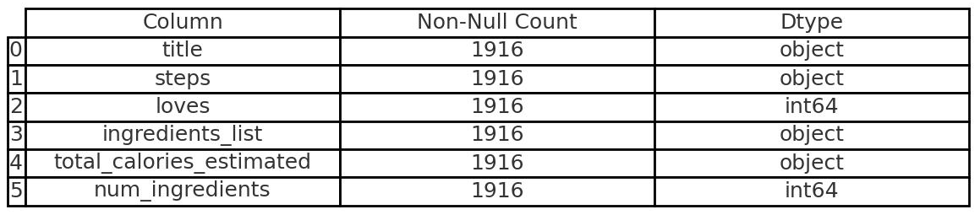
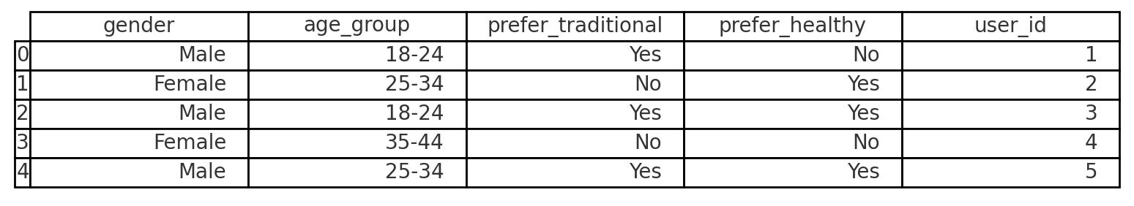
Project Steps for Analysis
5. Final Feature Structuring
Create df_recipe_revised DataFrame:
'title': The title of the recipe.
'steps': The steps involved in the recipe.
'loves': The number of people who love the recipe.
'ingredients_List': The list of ingredients required for the recipe.
'total_calories_estimated': The estimated total calories for the recipe.
‘num_ingredients’ : The number of ingredients in the recipe
Create consumer_profile DataFrame:
'gender': The gender of the consumer.
'age_group': The age group of the consumer.
'prefer_traditional': Whether the consumer prefers traditional food or not.
'prefer_healthy': Whether the consumer prefers healthy food or not
Dataframe Information
df_recipe_revised
consumer_profile

Slide 15
Project Steps for Analysis
6. Recommendation Model Creation
Dropdown for User ID Selection:
Use st.selectbox() to let users select a User ID from the list.
Display User Profile:
After selecting the User ID, display the user’s profile information such as Gender, Age Group, and Preferences for Traditional Food and Healthy Food.
Generate Recipe Recommendations:
Use a recipe recommendation model to generate a list of recommended recipes based on the user’s preferences and available recipe data.
Display Recipe Information:
If recipes are recommended, display:
Recipe title
Number of likes
Estimated calories per serving
If no recipes match, show a warning message.

Slide 16
Project Steps for Analysis
7. Segmentation Model Creation
Select Features for Clustering: Choose relevant features like total_calories_estimated, loves, and num_ingredients for clustering analysis.
Standardize Features: Use StandardScaler to normalize the data so that the features have the same scale, ensuring no feature dominates the clustering process.
Choose Number of Clusters (K): Use st.slider() to let users choose the desired number of clusters (e.g., between 2 and 10 clusters).
Apply K-Means Clustering: Apply the KMeans algorithm with the selected number of clusters to cluster the data based on the chosen features.
Assign Cluster Labels: Assign labels to each cluster based on total_calories_estimated and loves values, such as "High Calorie Favorites", "High Calorie", "Healthy Favorites", or "Healthy".
Use PCA for Visualization: Apply PCA (Principal Component Analysis) to reduce the dimensionality of the data to 2D, making it easier to visualize.
Scatter Plot Visualization: Use seaborn to create a scatter plot that shows the distribution of clusters based on the PCA results, enabling a 2D visualization of the data spread.
Correlation Visualization: Use a heatmap to display correlations between features like total_calories_estimated, loves, num_ingredients, and cluster, providing insights into the relationships between features.
Display Data by Cluster: Allow users to select a specific cluster using st.selectbox() or st.radio(), and display the recipe data within the chosen cluster.

Slide 17
Streamlit & Github Deliverables

Slide 18


All About My Streamlit Project!
https://finalprojectfajri-j4angay3v8h2o5wvhfuteq.streamlit.app/
https://github.com/Fajrimughni/Final_Project_Fajri
Notes:
1. Dampak Krisis Ekonomi 2008:
Krisis ekonomi memengaruhi distribusi kualitas jurnal, dengan peningkatan fokus pada jurnal berkualitas tinggi setelah tahun tersebut.
2. Peran Jurnal Berkualitas Baik:
Jurnal berkualitas baik tetap menjadi tulang punggung publikasi ilmiah, meskipun sempat menurun pada 2008.
3. Konsistensi Jurnal Berkualitas Sedang:
Kategori ini menunjukkan dinamika yang fluktuatif, mencerminkan kebutuhan untuk menyeimbangkan kuantitas dan kualitas(mungkin karena aksesibilitas atau relevansinya dengan kebutuhan umum).

Slide 19
Thank You

